Slide 1
“Mini AI Study Buddy – An AI Powered Learning Assistant”
CAPSTONE PROJECT
Presented By:
Student Name- Rupali Dadasaheb Garule
College Name- MSS’s College of Engineering and Technology, Jalna
Department- B.Tech Computer Science and Engineering

Slide 2
OUTLINE
Problem Statement (Should not include solution)
Proposed System/Solution
System Development Approach (Technology Used)
Algorithm & Deployment
Result
Conclusion
Future Scope
References

Slide 3

Problem Statement
In today's digital learning environment, students frequently encounter significant challenges when attempting to understand complex concepts during self-study sessions. Although vast amounts of information are readily available online, search results often present lengthy explanations or irrelevant content that makes learning confusing and unnecessarily time-consuming.
Furthermore, teachers and mentors may not always be available to answer students' questions instantly, creating gaps in understanding. Revising large volumes of study material remains challenging, and students often lack effective tools to test their comprehension through practice questions or quick revision methods like flashcards.
There is a clear need for an intelligent learning assistant that can simplify concepts, summarise study materials, and provide interactive ways for students to practise and revise effectively.

Slide 4
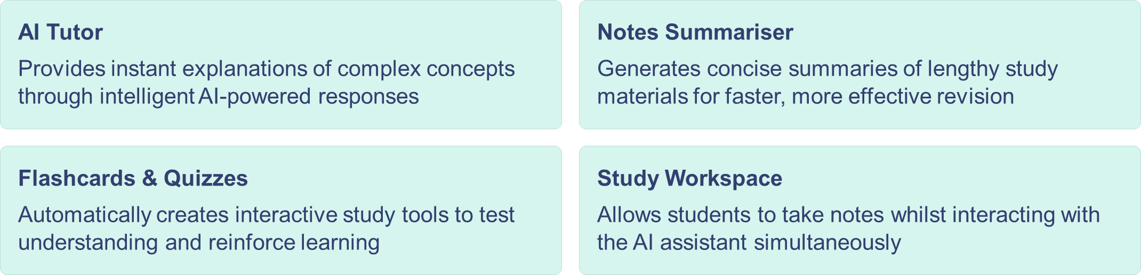
Proposed Solution
To address the challenges faced by students during self-study, I developed Mini AI Study Buddy, an intelligent AI-powered learning assistant designed to make studying more efficient, interactive, and accessible. The system leverages advanced artificial intelligence to provide instant support to students.
By integrating these features into a single platform, Mini AI Study Buddy provides a smart and personalised learning environment that enhances students' comprehension, revision, and overall learning experience.

Slide 5
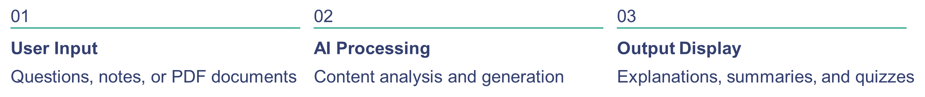
System Approach
Technology Stack
Design Principles
Python programming language for backend development
Streamlit framework for creating interactive web interface
Groq LLM (LLaMA 3.1 model) for AI-powered responses
PyPDF2 library for PDF document processing
Streamlit session state for progress tracking
The system was designed using a modular architecture to ensure scalability, maintainability, and organised code structure. The platform accepts various user inputs including text queries, study notes, or uploaded PDF documents.
Streamlit session state maintains chat history, tracks quiz performance, and stores user progress throughout the learning journey.

Slide 6
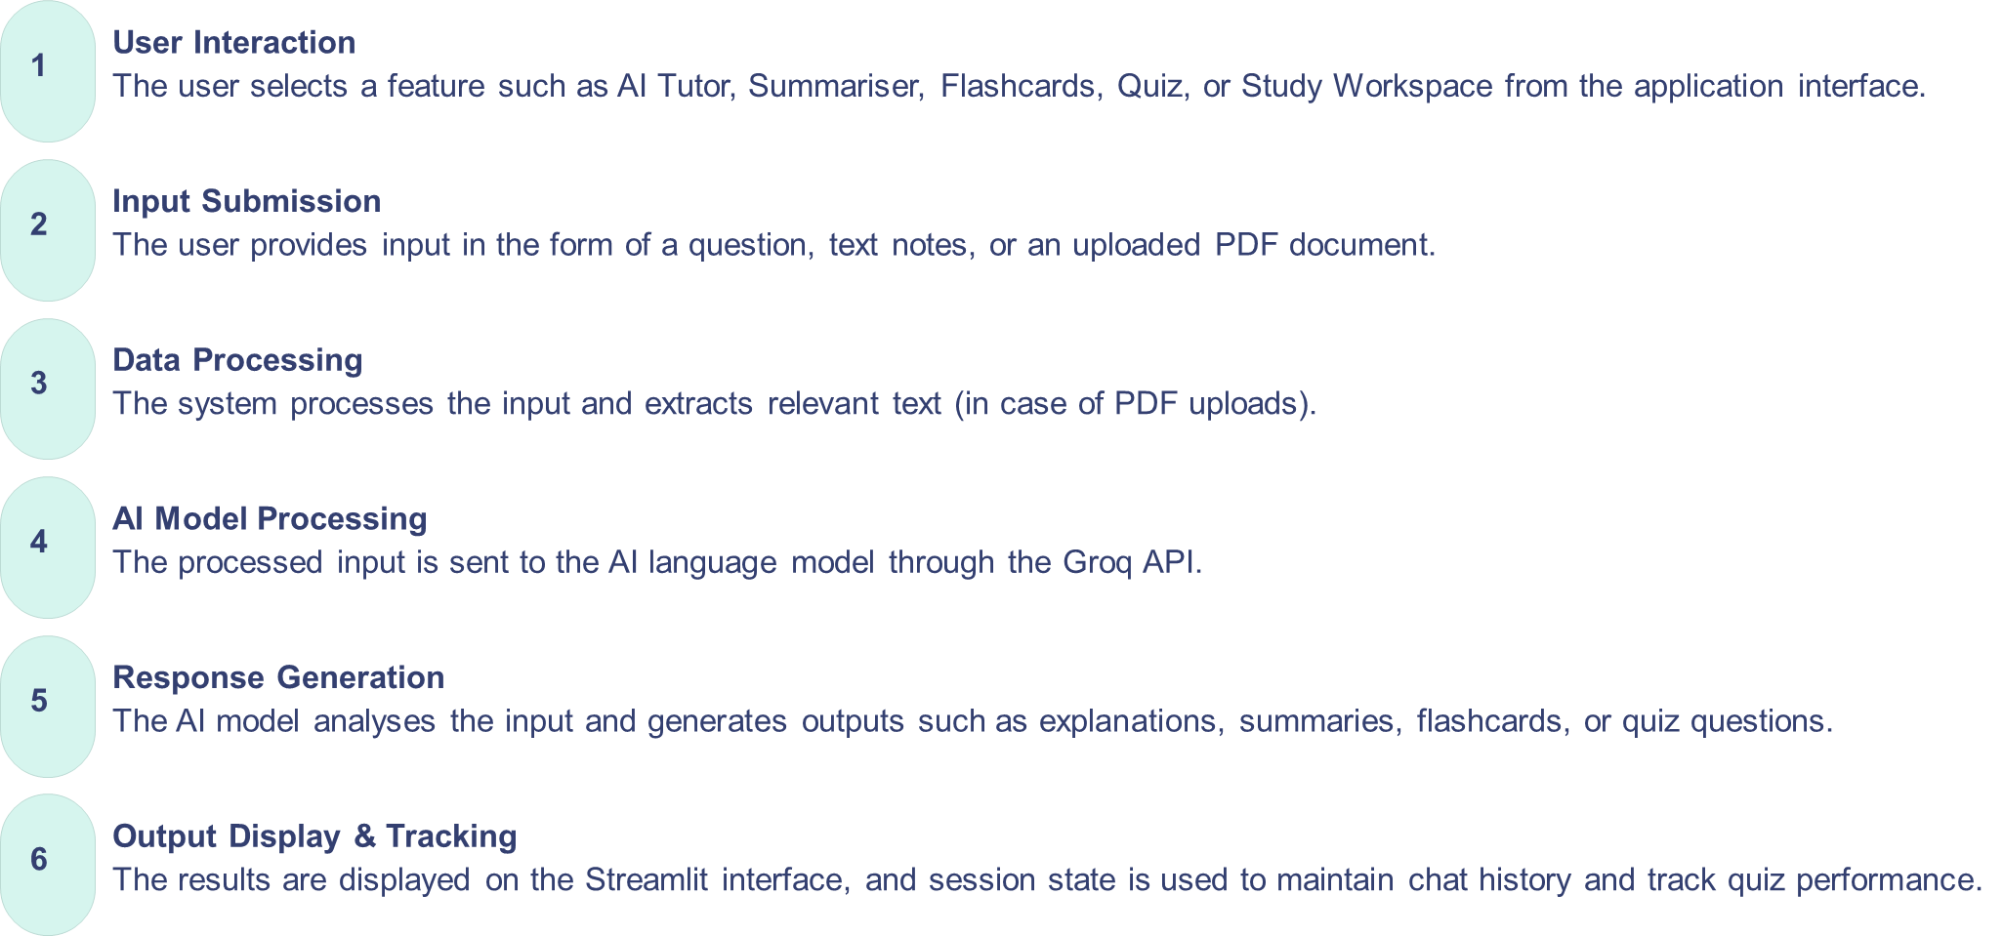
Algorithm & Deployment
Algorithm (System Workflow)
The Mini AI Study Buddy follows a systematic workflow to provide seamless and intelligent assistance to students. Each stage is crucial in transforming user input into valuable learning resources.

Slide 7
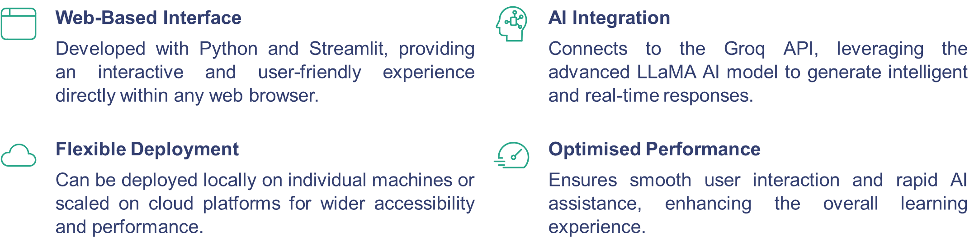
Deployment
Mini AI Study Buddy is designed for flexible and efficient deployment, ensuring broad accessibility and seamless user interaction through its robust architecture.
This strategic deployment approach guarantees that students can access the Mini AI Study Buddy effectively, whether from a personal device or a shared online environment, facilitating consistent and powerful AI support.

Slide 8
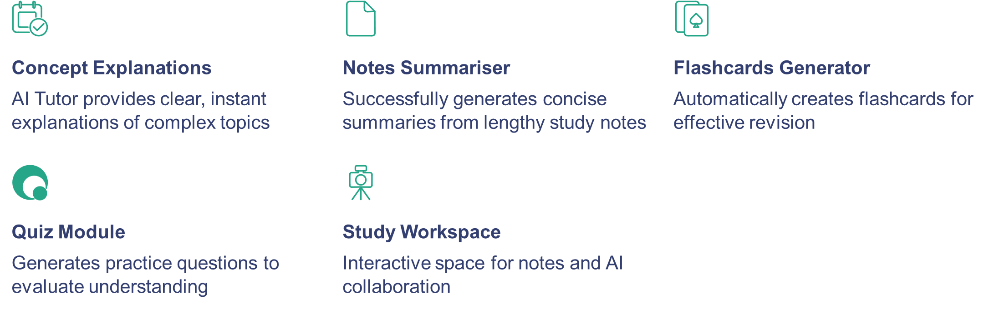
Result
The Mini AI Study Buddy application was successfully developed and tested as an interactive AI-based learning platform. The system effectively provides AI-generated explanations for complex concepts through the AI Tutor feature.
Overall, the system improves learning efficiency, engagement, and self-study experience for students by providing a comprehensive suite of intelligent learning tools.

Slide 9
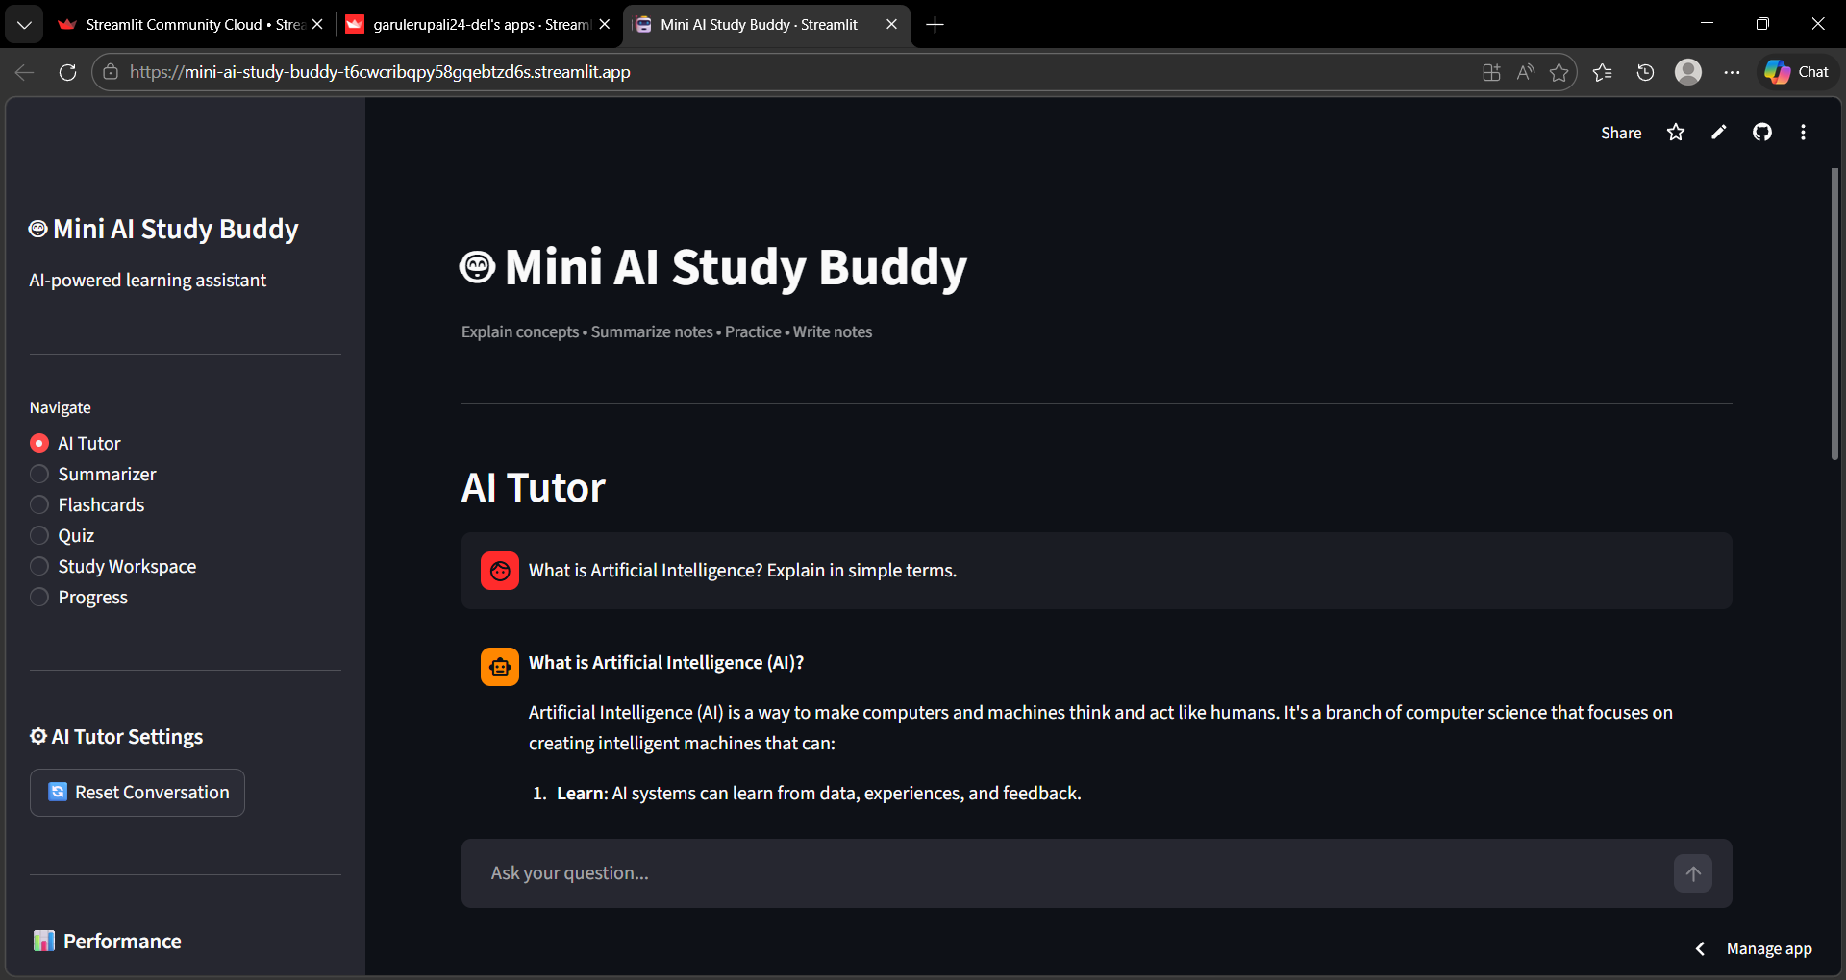
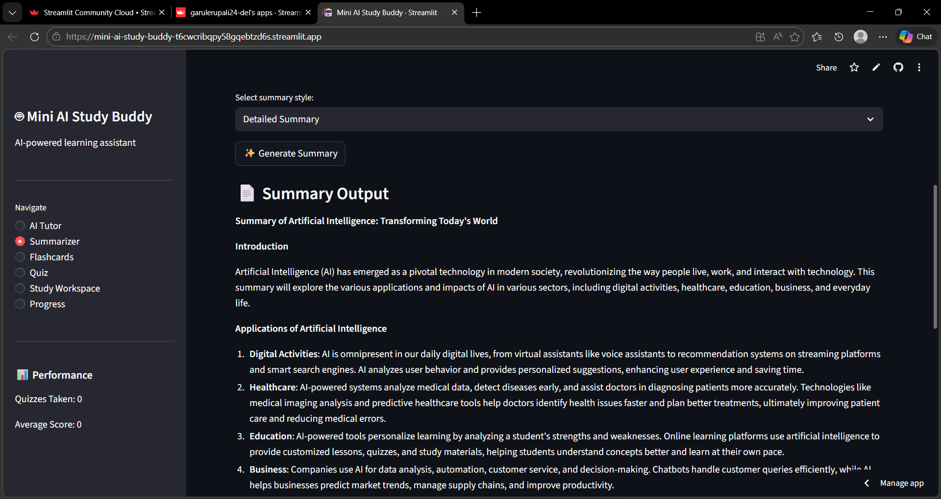
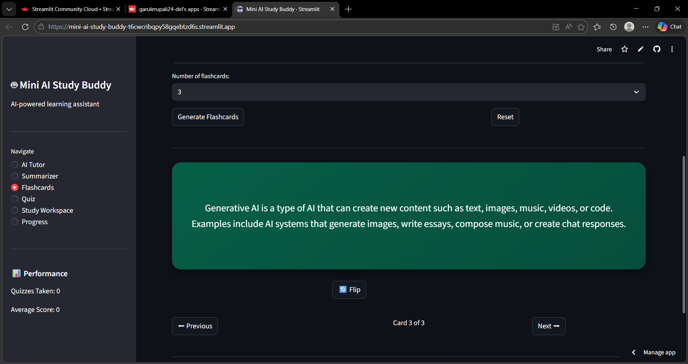
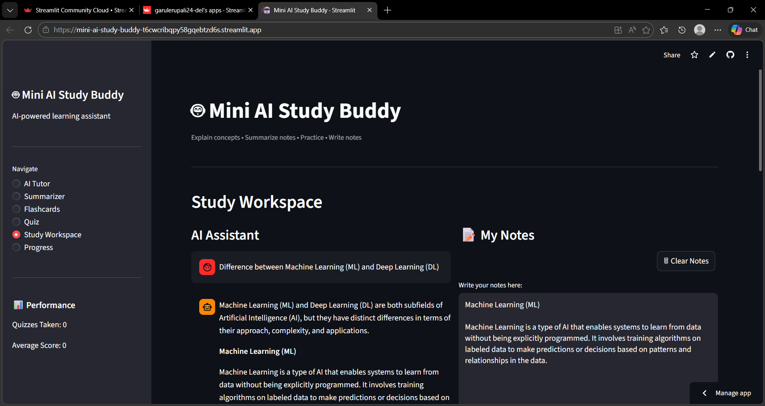
Mini AI Study Buddy – Live Web Application (Streamlit Deployment)

Slide 10
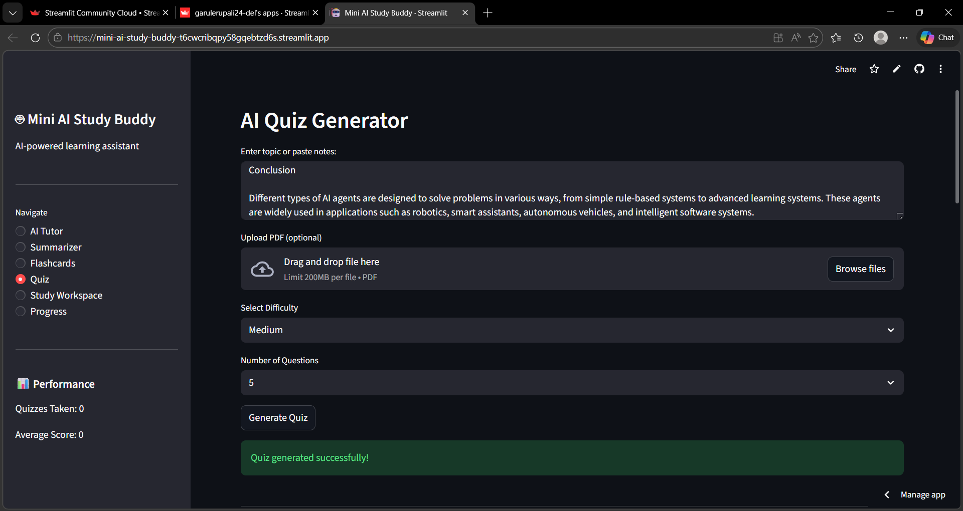
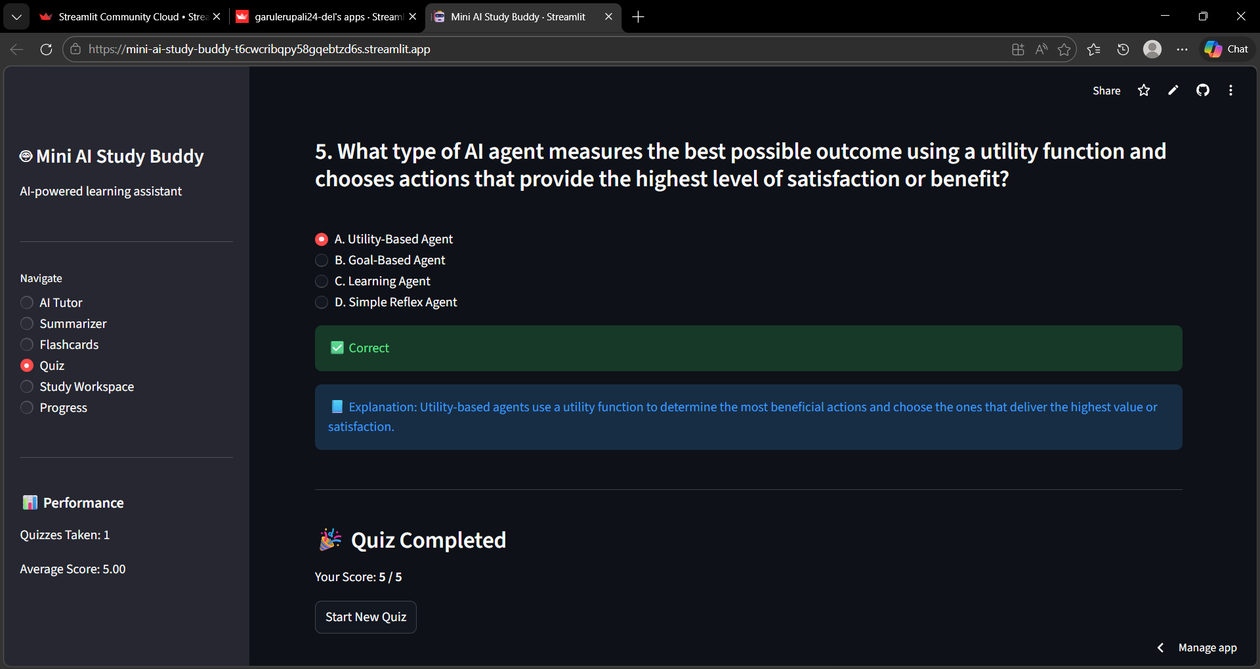
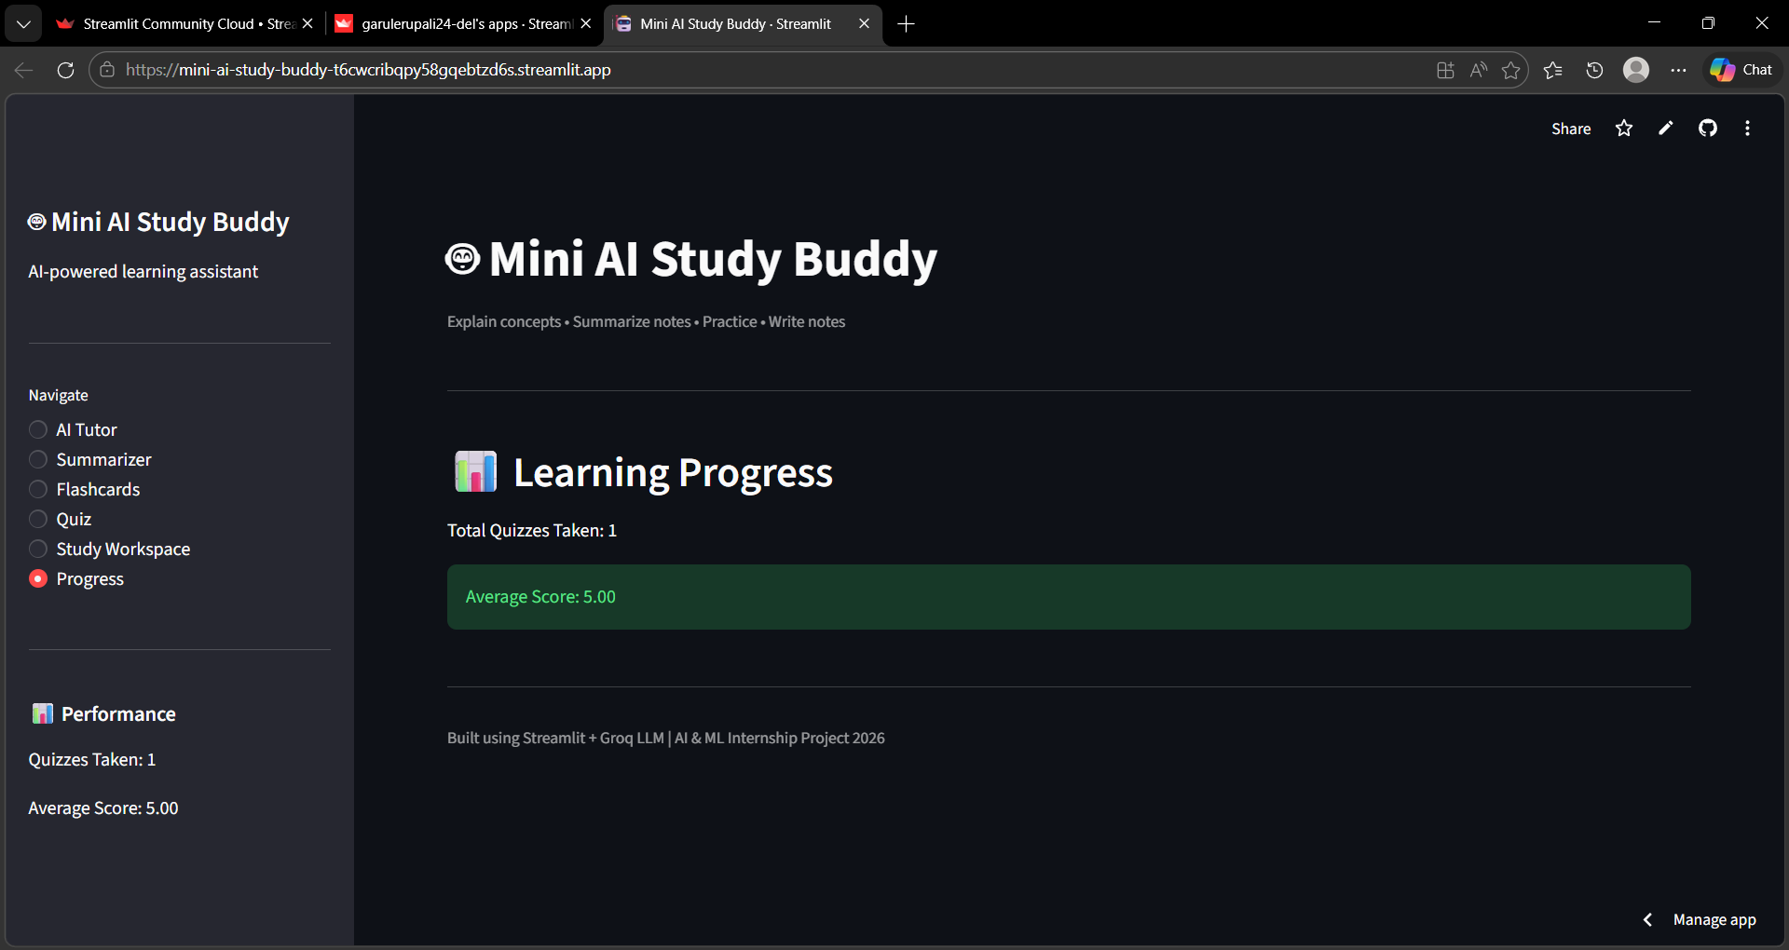
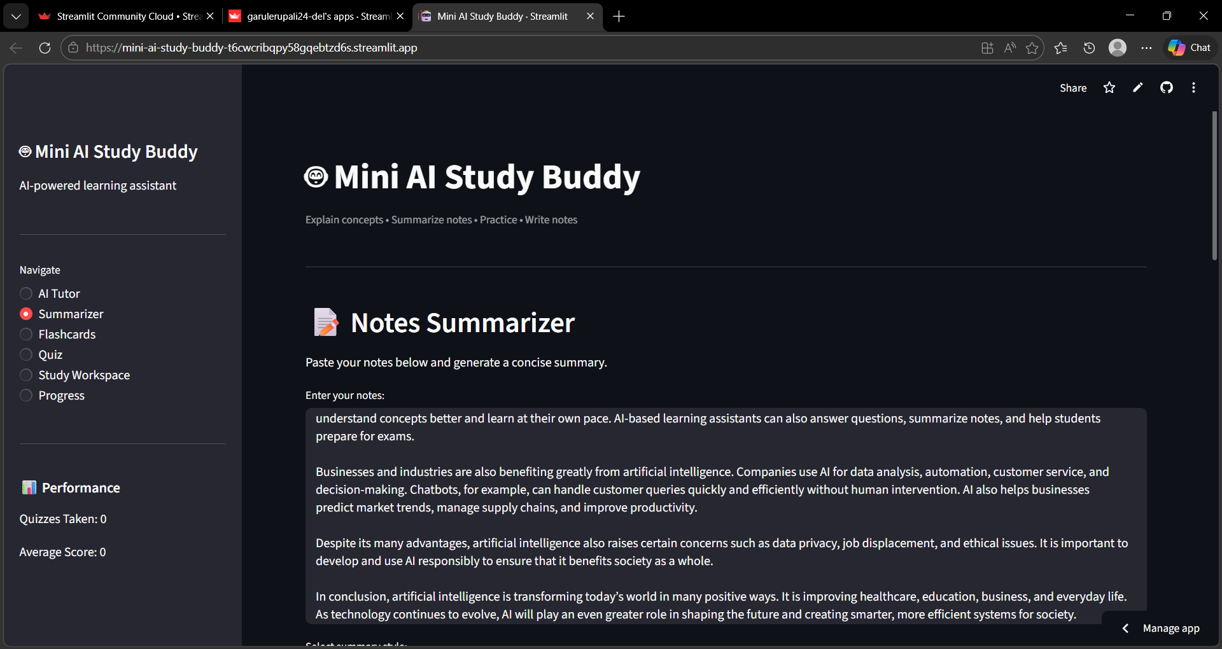

Slide 11
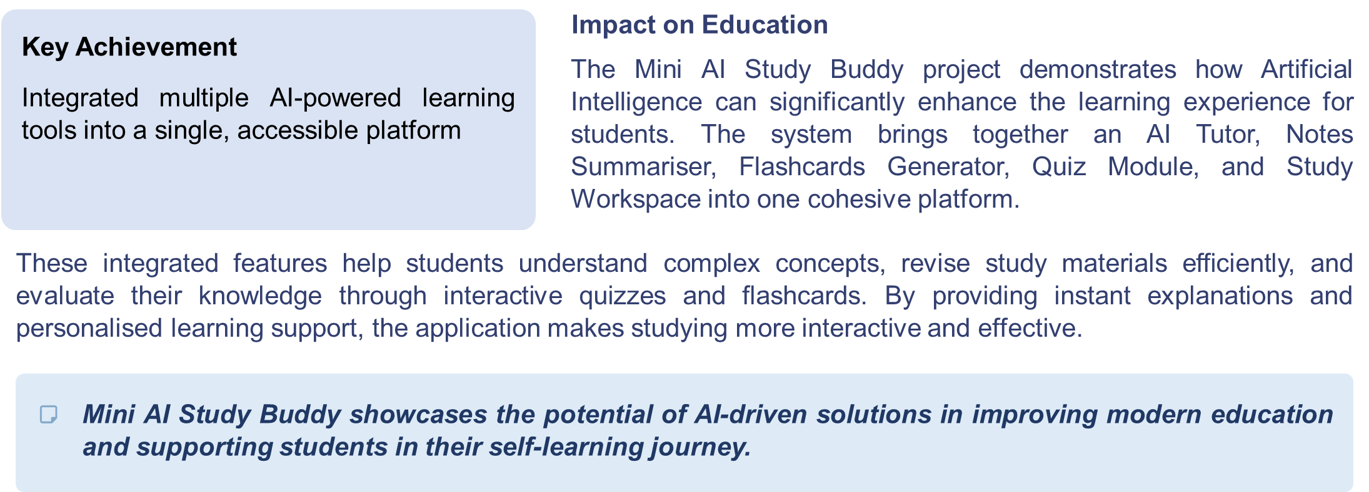
Conclusion

Slide 12
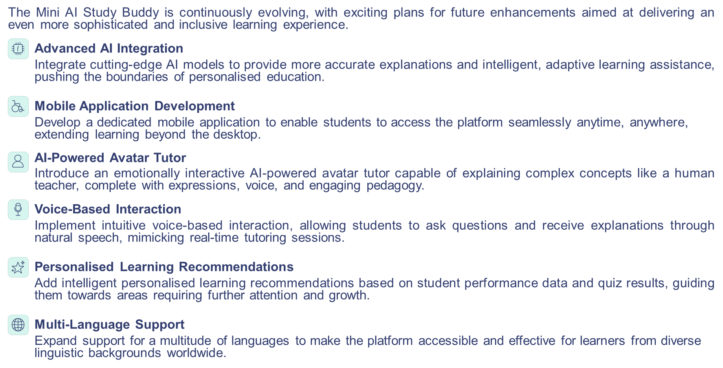
Future scope

Slide 13
References
Python Documentation
Streamlit Documentation
Official Python programming language documentation and resources
Streamlit framework documentation for web application development
https://www.python.org
https://docs.streamlit.io
Groq API Documentation
PyPDF2 Library
Groq API documentation for AI model
Integration
PyPDF2 library documentation for PDF
processing functionality
https://console.groq.com/docs
https://pypdf2.readthedocs.io
Additional resources include research articles and online materials on Artificial Intelligence in Education, as well as technical tutorials and documentation related to AI-based learning systems.

Slide 14
Project Links
GitHub Repository:
https://github.com/garulerupali24-del/mini-ai-study-buddy
Live Application (Streamlit Deployment):
https://mini-ai-study-buddy-t6cwcribqpy58gqebtzd6s.streamlit.app/

Slide 15
Acknowledgment
I would like to sincerely thank Edunet Foundation and AICTE for providing this valuable opportunity through the Artificial Intelligence and Machine Learning Internship Program.
This internship helped me gain practical exposure to AI technologies and guided me in successfully developing the project “Mini AI Study Buddy.”
I also express my gratitude to my mentors and faculty members for their continuous support and guidance.

Slide 16
THANK YOU

